Slide 1
Gold price prediction
Machine learning project

Slide 2
Dataset
A dataset, as the name suggests, is a collection of data. In Machine Learning projects, we always need a dataset. Firstly, we need the training dataset to train our model, to help it predict. Then, we use testing datasets to predict and check how accurate is our model.

Slide 3
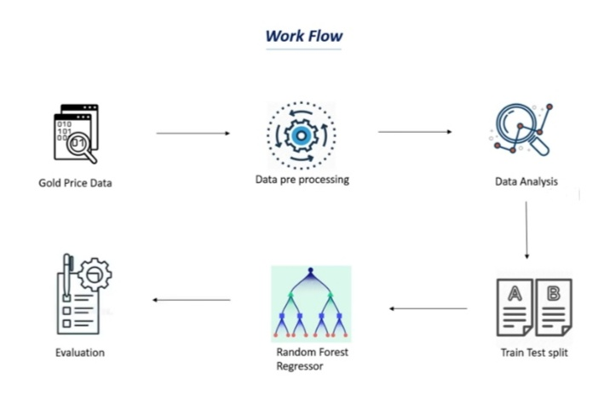
Work flow

Slide 4
Importing the dependencies :
import pandas as pd
import matplotlib.pyplot as plt
import seaborn as sns
from sklearn.model_selection import train_test_split
from sklearn.ensemble import RandomForestRegressor
from sklearn import metrics

Slide 5
Conclusion
As you saw in this project, we first train a machine learning model, then use the trained model for prediction. Similarly, any model can be made much more precise, by feeding a very large dataset, to get a very accurate score (but it will be pretty time-consuming). For a beginner, I feel the dataset that I had used was pretty decent.

Slide 6
Thank you

